Slide 1

AI-Powered Sales Forecasting Dashboard
Predictive Analytics using Time Series Modeling & Power BI
Presented by Pratik Jagtap, AI / ML Engineer
Tools Utilised: Python, Jupyter Lab, Time Series (Prophet), Power BI

Slide 2


Project Overview
Problem Statement
Solution
Retail businesses struggle to predict future sales accurately due to seasonality, trends, and demand fluctuations.
Built an AI-powered sales forecasting system that:
Predicts future sales using historical data
Identifies trends and seasonality
Presents insights through an interactive Power BI dashboard

Slide 3

Business Objective
Build an interactive dashboard with filters and insights
Forecast future sales using time-series modeling
Compare actual vs forecasted sales
Track forecast accuracy using error metrics

Slide 4

Data Preparation & Feature Engineering
Cleaned missing and inconsistent values
Aggregated sales monthly levels
Created features
Prepared data in a time-series friendly format
Combined Prophet’s predicted values with the actual monthly sales
Calculated the Error in model

Slide 5


Model Selection
Why Time Series Forecasting?
If You know time series models then you might have wondered why prophet model ?
Prophet is well suited for businesses because we compared it to ARIMA/SARIMA & XG Boost prophet requires less manual tunning and it automatically handles trend and seasonality.

Slide 6





Model Training & Forecasting
Trained Prophet on historical sales data
Generated future sales forecasts
Extracted:
Validated results using actual vs forecast comparison
Trend component
Seasonal patterns
Upper & lower confidence bounds

Slide 7
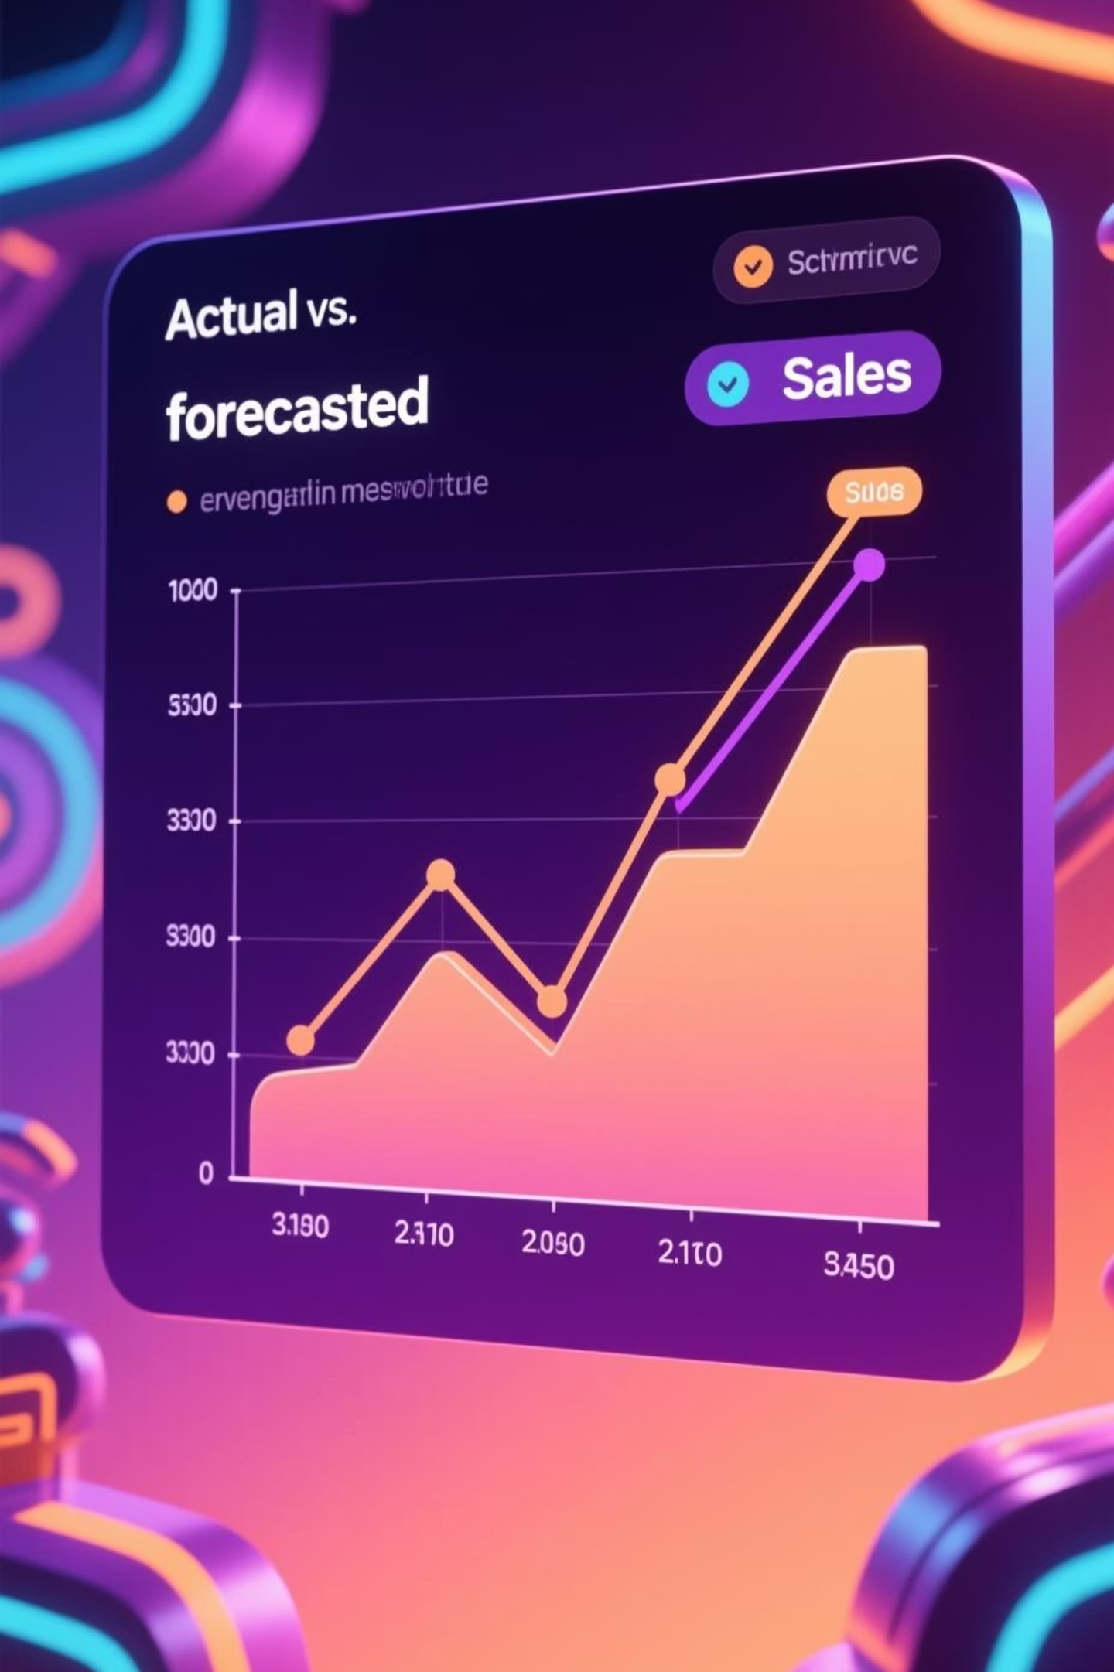

Forecast Evaluation
To ensure the reliability of our predictions, a comprehensive evaluation approach was undertaken.
1
Evaluation Approach
Compared historical actual sales vs predicted values
Used error metrics:
R square Score
Adjusted R square
Mean Absolute Percentage Error
Mean Squared Error
2
Outcome
Model captured overall sales trend accurately
Seasonal patterns aligned with real sales behaviour

Slide 8

The Power BI Dashboard
Our interactive Power BI dashboard is designed to translate complex forecasting data into easily digestible, actionable insights for business users.
Key Dashboard Features
Actual vs. Forecasted Sales Trend
Monthly & Yearly Sales Comparison
Forecast Confidence Intervals: Offers insight into prediction reliability.
Date/ Time Slicers
Cards
Top Selling Products
Low Seasons & High Seasons

Slide 9




Key Takeaways
This project showcases a robust blend of data science tools and critical technical skills.
End-to-end ML project from raw data to dashboard
Facebook Prophet
Strong combination of AI + business intelligence
Demonstrates real-world forecasting use case
Skills Demonstrated
Time series forecasting
Data cleaning & feature engineering
Predictive modeling
Business-focused data visualization
Storytelling with dashboards
Translating ML output into business insights

Slide 10
Thank You

